Slide 2
Notes:
Over the summer, many young people and their families lose access to critical supports that keep them safe, healthy, and engaged in learning and meaningful experiences.

Slide 3
Notes:
Summer programs can help schools achieve their broader goals.
Robust summer programs can be helpful in maintaining and improving student performance over time, according to a 2016 Rand Corp. study of more than 5,000 elementary school students.
Students who attended voluntary summer programs that combined academics and enrichment were better off in math and reading and also in “social-emotional” skills such as self-awareness and regulation, the study found.

Slide 4
Notes:
Indy Summer Youth Programs give Marion County kids and teens summer fun and enrichment.
Families can choose the best fit from 200+ programs, including sports, arts and culture, youth employment, nutrition and STEM (science, technology, engineering and math).
Indy Summer Youth Programs are available for kids and teens ages 4-22, with full and half day program options.

Slide 5
Notes:
Scholarships and free and low-cost enrollment options are available. Many programs provide healthy meals and snacks, and some programs focus on serving youth with disabilities

Slide 6
Notes:
Many students and families are unaware these summer learning options exist, or wait too long to sign up, causing them to miss out on scholarship opportunities.

Slide 7
Notes:
Note: this slide is a build. Each box appears with a mouse click.
You can help spread the word about Indy Summer Youth Programs:
Plant the seed early and encourage parents to sign up early to take advantage of scholarships.
Help families fill out forms and let them know there may be a sliding scale on prices.
Put up visual images of summer opportunities in classrooms and hallways.

Slide 8
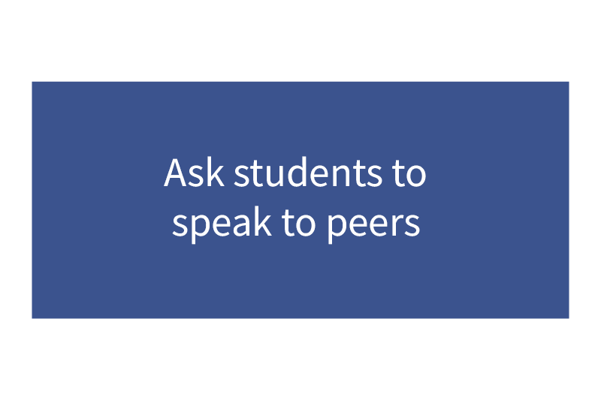
Notes:
Note: this slide is a build. Each box appears with a mouse click
You can help spread the word about Indy Summer Youth Programs:
Leverage what you know about students’ interests and keep an eye out for fitting activities and programs.
Ask families to talk to each other about opportunities, especially families that have already been through the summer planning process or experienced camps they liked. This can help break down fears and apprehension about safety, and even encourage families to send students or siblings in pairs or groups to camps and activities.
Ask students to speak to peers to spread the word and mentality of—if I can do this, you can do this too. For example, students present on what they did last summer at a summer fair, school assembly, or during a class.

Slide 9
Notes:
Learn more at indysummerprograms.org and help get the word out to students and families.

